Slide 1
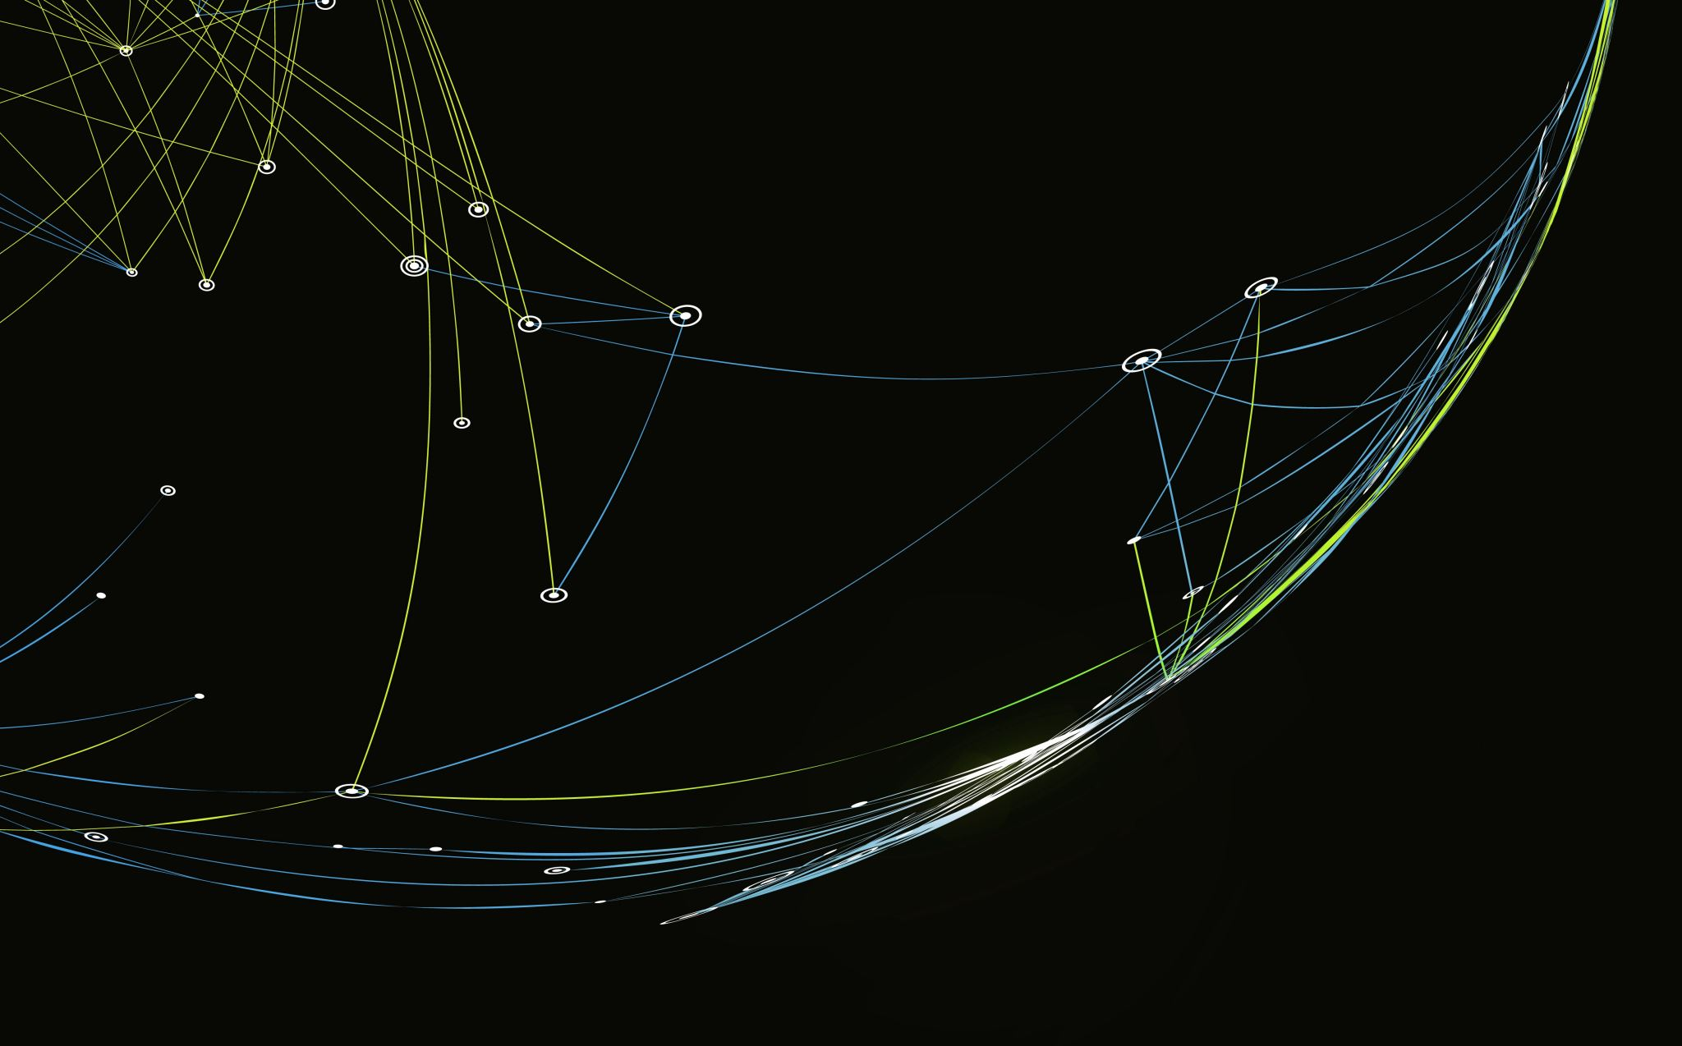
Snake
B123040044 侯廷翰

Slide 2
Why make snake game?

Slide 3
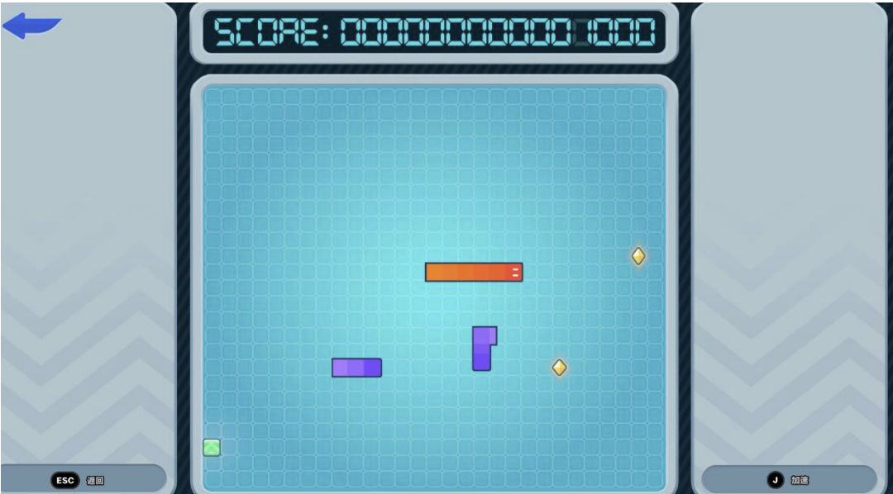
Insipired by zenless zero

Slide 4

Let’s see the code

